Slide 1
14-1 Gunplay
5CM503 Virtual Environment Development
Dr Patrick Merritt

Slide 2
Contents
Gunplay

Slide 3
What do we mean by “Gunplay”
How good do the weapons feel within the game?
Worth a watch https://www.youtube.com/watch?app=desktop&v=xxFEngt0REU&t=510s&ab_channel=OperatorDrewski

Slide 4
What do we mean by “Gunplay”
How good do the weapons feel within the game?
Better described as how convincing the guns are within the game.
Do they feel good to shoot?
Do they feel good to aim?
Do they feel good to aim?
Worth a watch https://www.youtube.com/watch?app=desktop&v=xxFEngt0REU&t=510s&ab_channel=OperatorDrewski

Slide 5
What makes a gun feel good?
As with just about everything in this module it depends…

Slide 6
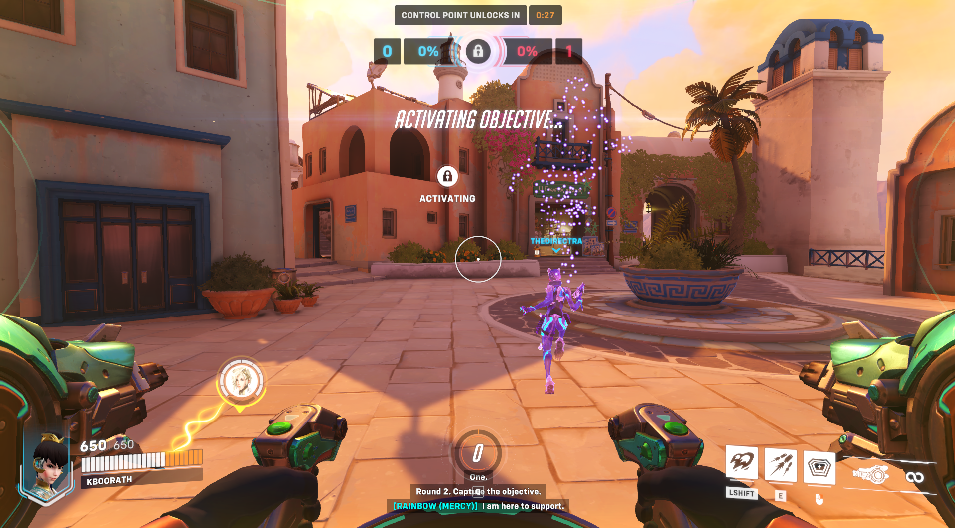

Slide 7
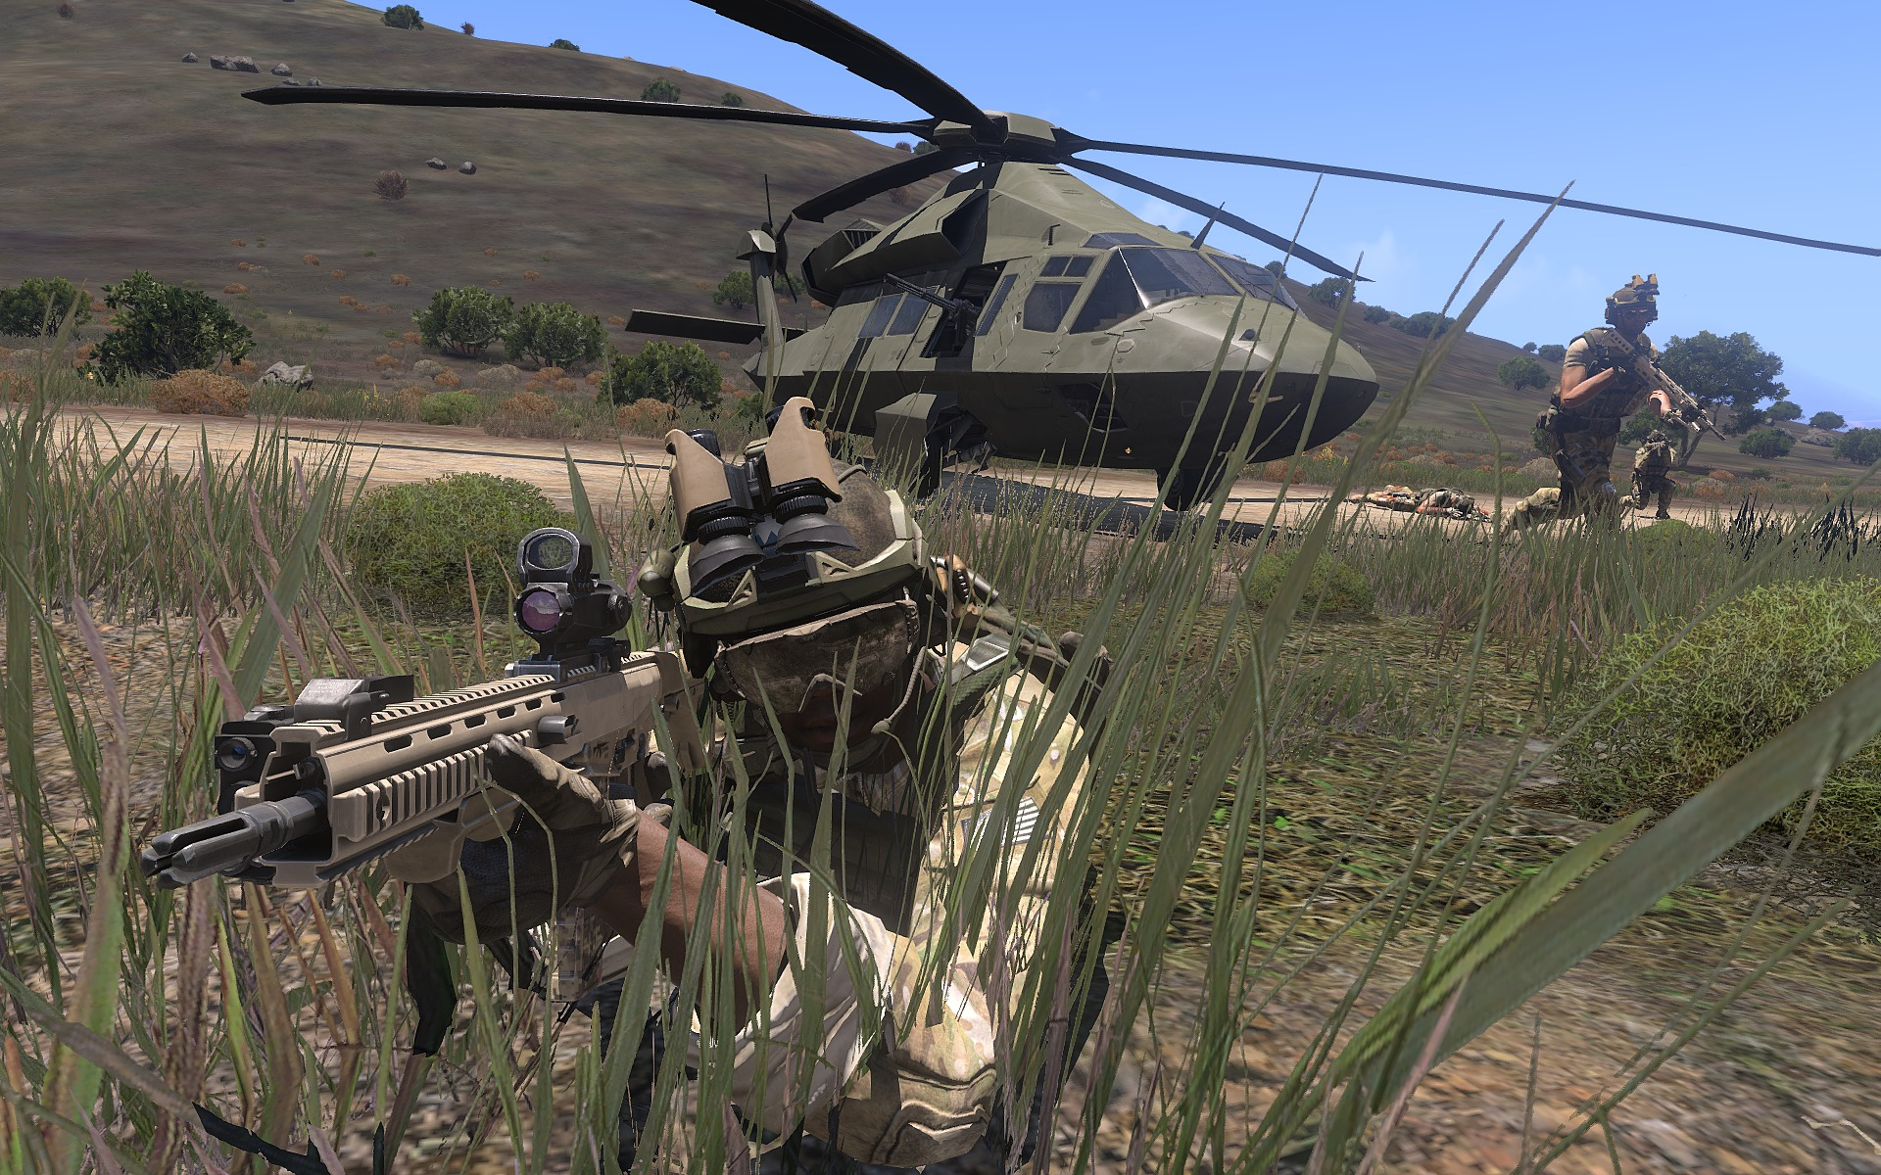

Slide 8
Close work with the artists
As the gun takes up a quarter of the screen, it’s important to “know” what is in that quarter.
It’s the primary method of interacting with the game, and the tool with which the player is defending themselves.
If it feels bad, the game usually will feel bad…
If the visuals and performance do not match it can leave the player confused…

Slide 9
Accuracy and licencing…
Gun manufacturers own the rights to the designs of their guns.
This means you can’t just stick any modern gun you like in a game and use its name, you would have to pay a licence.
Most classic guns such as the AK-47 can appear in so many places as the patent on the design has expired…
So you either,
Make a deal with the manufacturer.
Or make a variation and change the name slightly
So a lookalike P-90 called the Q-91 is probably OK.

Slide 10
Terms…
Time to kill
No, I’m not just trying to sound edgy.
It’s the term given to the average amount of time to kill an enemy with a weapon.
Short TTK (time to kill) means weapons
deal more damage
are more accurate
and combat is generally more dangerous.
Long TTK means weapons
Deal less damage
Are less accurate
And combat usually lasts longer

Slide 11
Modelling TTK
Depends on the game, but it can be modelled in multiple ways…
Mathematical modelling is usually the starting point.
At this range I can see this much of the target there for I should hit this many times giving an average TTK of x seconds.
This usually does not survive contact with players…
Statistical modelling
At this range the player on average killed that player in x seconds.
Averaged over the whole player base gives a TTK of x seconds.
Widely variable by skill…

Slide 12
Aim down sight (ADS)
Ads is the time it takes to bring the weapon from a standard “hip fire” position to an aimed sighted position.
Usually in modern games accuracy is reduced significantly in hip-fire mode.
Other features may also be missing such as a crosshair.
Aiming down the sight increases accuracy by zooming the camera into the sight and placing it in a more central position.
But this also reduces peripheral vision making it harder to see what's around you.

Slide 13
Recoil
Movement of the gun in the opposite direction of the bullet.
“If two bodies exert forces on each other, these forces have the same magnitude but opposite directions.”
“For every action there is an equal and opposite reaction”
The action of firing the gun sends an equal force into the gun which is transmitted to the shooter.
This causes the muzzle to climb and deviate from the desired direction of shooting.
Compensated after each shot, more recoil longer compensation.

Slide 14
Stability
The ability of the weapon to be kept on target pointing in the correct direction.
Affected by many factors in the real world such as…
Training
Strength (guns are surprisingly heavy)
Weight of the weapon
Distribution of the weight.
Manifests in games as sight sway in all directions.

Slide 15
Fire rate
The number of rounds the weapon can send “downrange” over example,.
Commonly specified per minute.
Unusual for a magazine to support continuous firing for a minute.
For example a standard M4 shoots 700 – 950 rounds a minute
Standard magazine size is a 30-round box.
Higer fire rates lead to less time to compensate for recoil making the gun harder to control.

Slide 16
Projectile velocity
The speed at which the bullet travels after leaving the barrel of the gun (often referred to as muzzle velocity).
Commonly constant in videogames
Slows down over distance for real life.
How fast the bullet travels through the game world.
Slow-moving projectiles are simulated as actual objects.
Fast-moving objects are usually resolved as line traces (“hit scan weapons”).

Slide 17
Effective range
How far away a bullet can be expected to have the desired effect on the target.
Shots beyond this range have a less-than-desirable effect on the target due to
Loss of energy rendering the round ineffective.
Degradation of projectile accuracy to the point of the shot being non-viable.
Commonly simulated with a drop off in damage based on distance or time between shooter and target.

Slide 18
Sights
The system used to line up the shot with target.
Most weapons default to “iron sights”
Physical markers at the front and rear of the gun that when lined up show the direction the shot will go.
Most modern weapons support varying optics for easier “target acquisition”.
At extreme range optics require adjustment or compensation to function correctly.

Slide 19
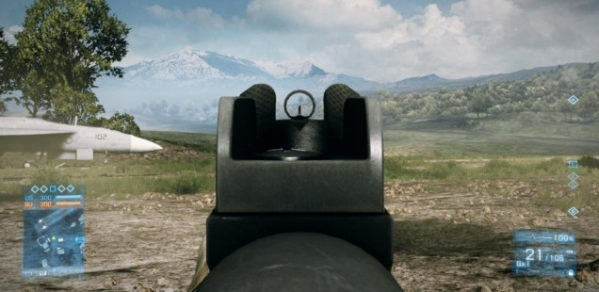
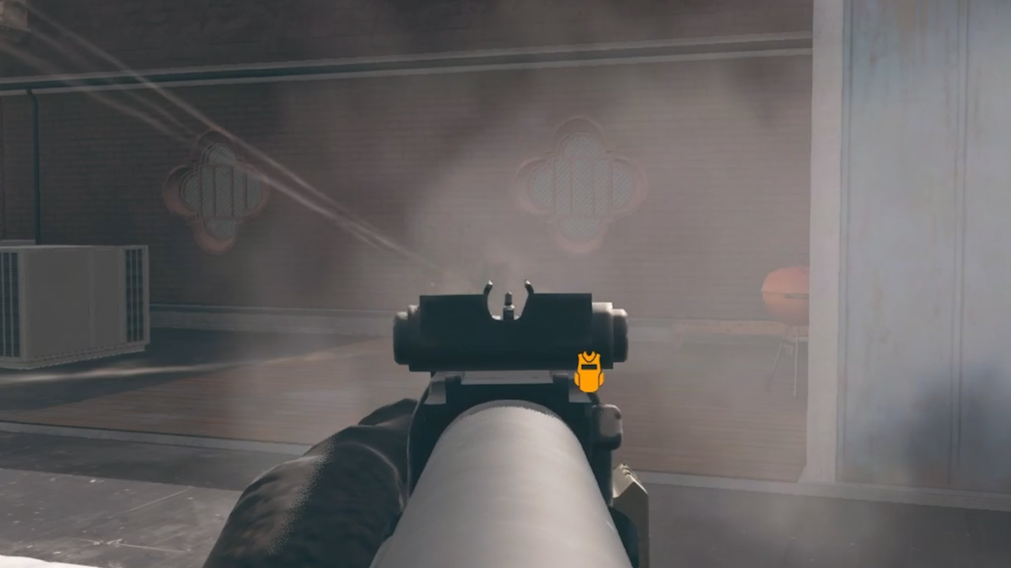
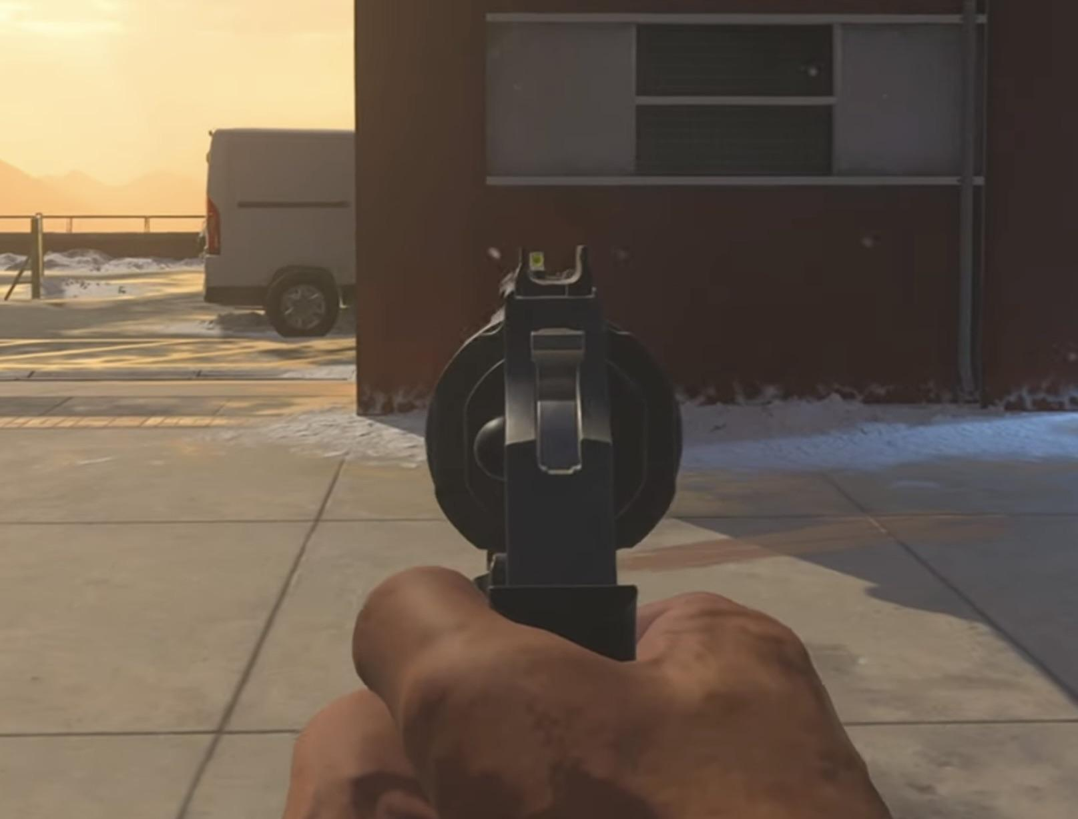
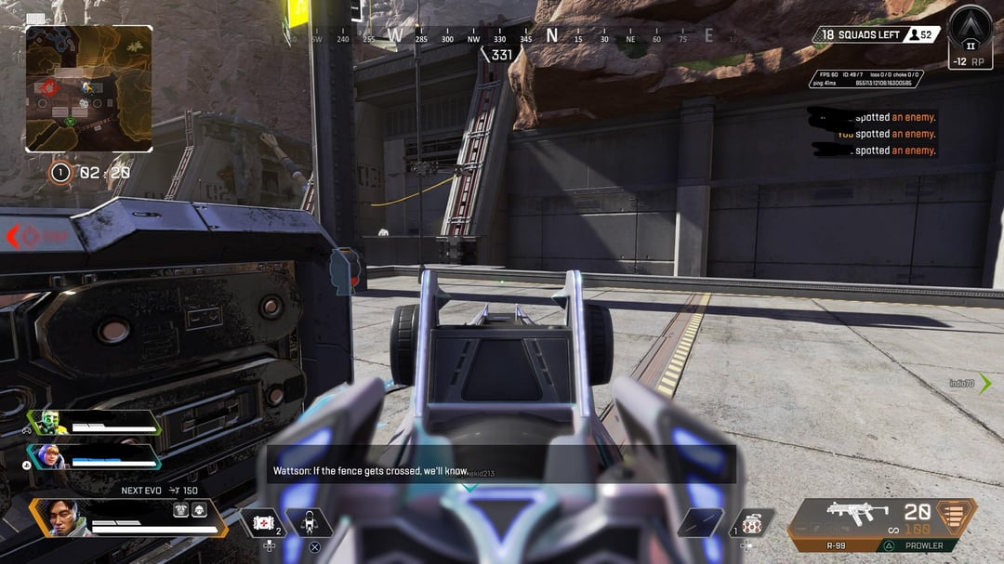

Slide 20
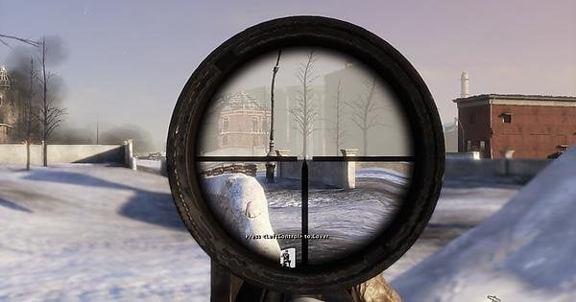
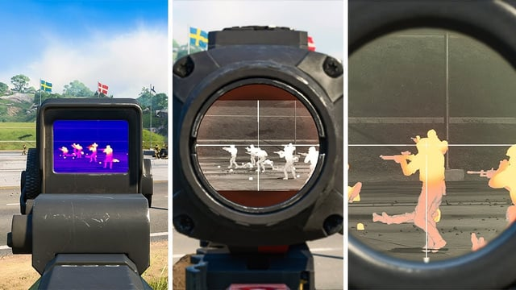
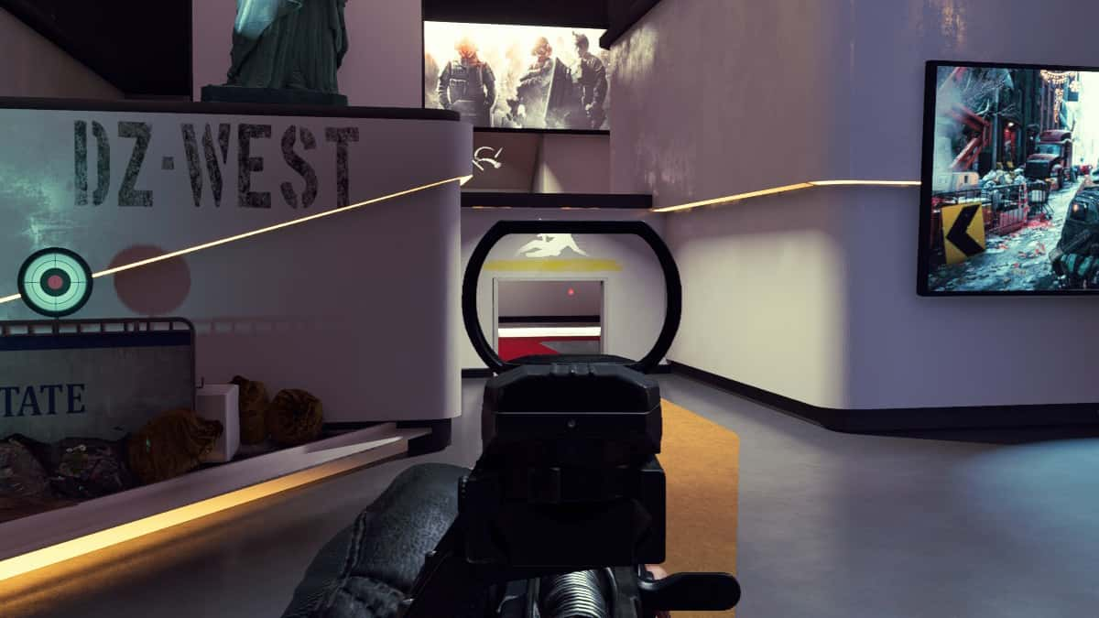
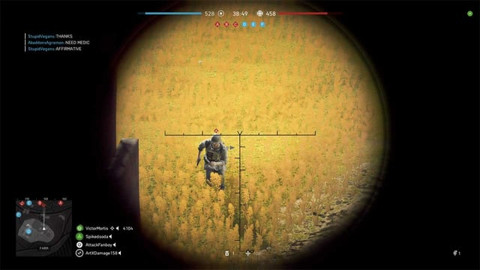

Slide 21
“Magic” stats
Refers to the gamification of realistic firearms.
Changes that don’t affect the visuals of the firearm, but improve its effectiveness in some way.
+1 accuracy
+5 to magazine size
+100 range
These effects can be natural or supernatural.

Slide 22
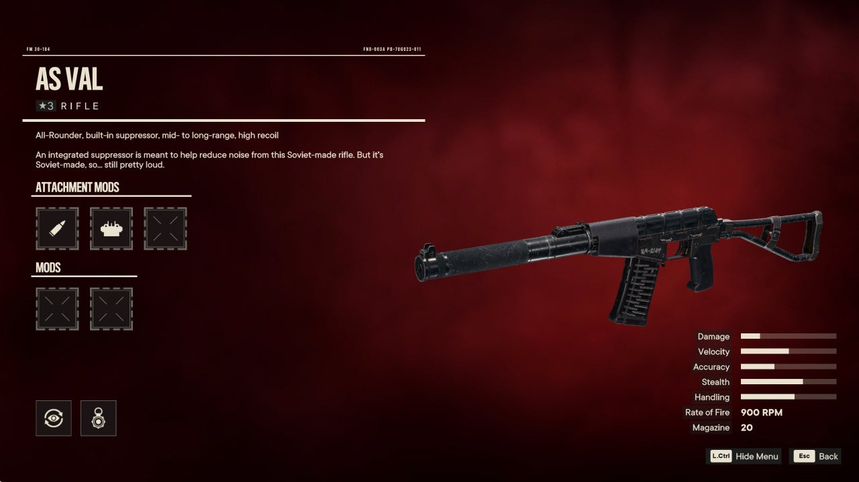

Slide 23
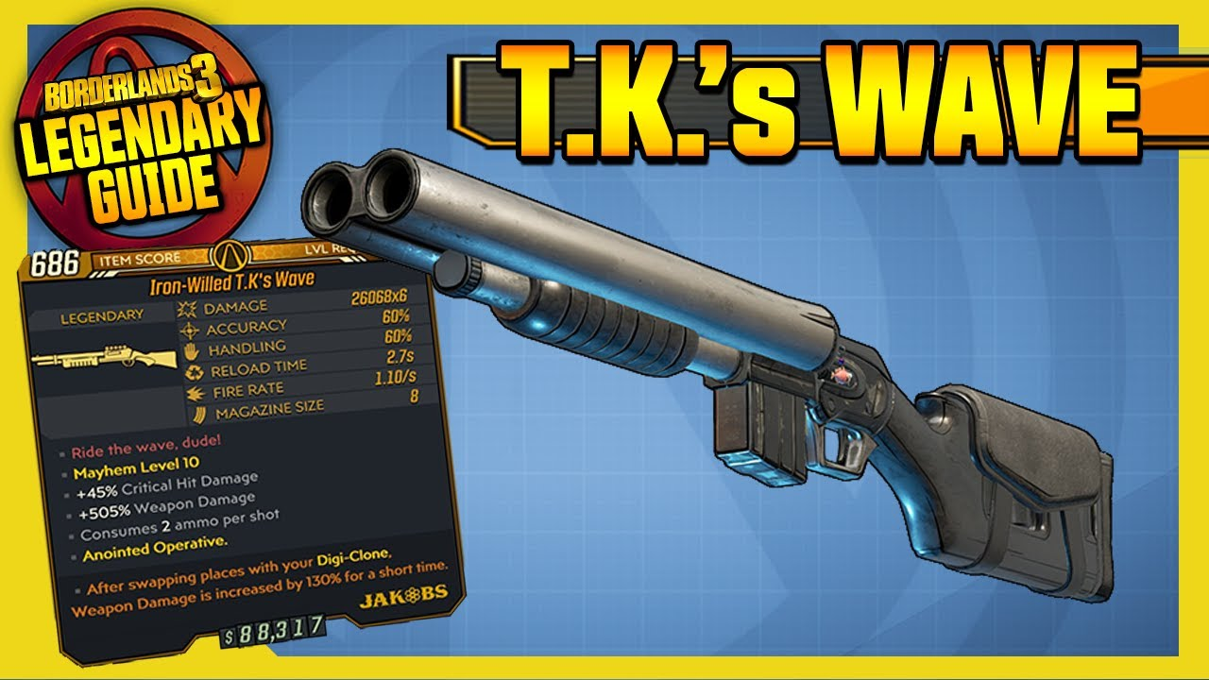

Slide 24
Customisation
Customisation is a key part of most modern games
Particularly in games as a service model (GaaS more on this later).
It is not enough for me to be better than you at the game, I must SHOW you I am better than you.
Also allows players to adjust the gun performance somewhat to match their preference.

Slide 25
Customisation (Cont)
Fortunately, most modern firearms are designed to be modular.
Grips, scopes magazines and stocks can be changed among other things.
This usually means most guns are modelled in multiple parts and combined to create the final weapon.
The meshes may or may not be combined before play depending upon the ease of changing attachments during gameplay.
Changing parts usually accompanies a stat change.

Slide 26
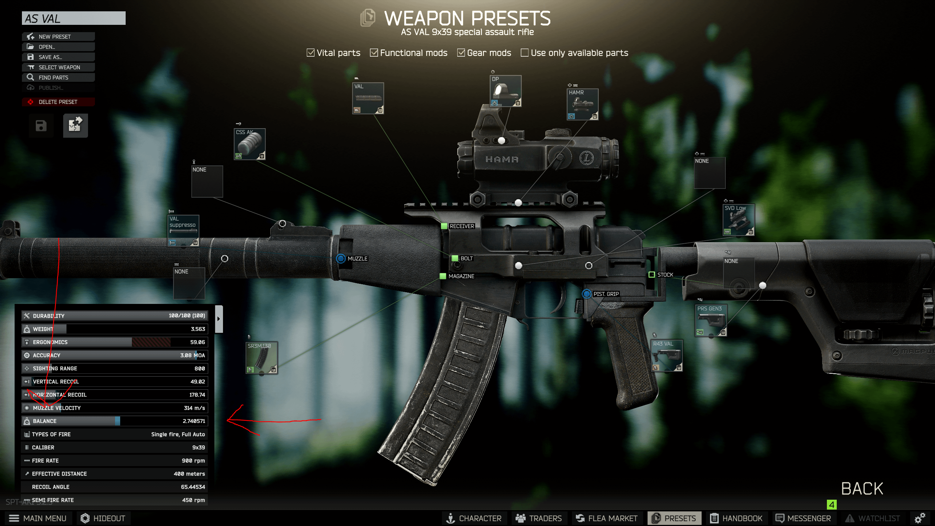

Slide 27
Customisation (Cont)
Commonly gun skins can be changed to match a users preference (particularly in competitive multiplayer environments).
Skins can be unlocked via gameplay signifying significant achievements or purchased with currency.
Skins may have a gameplay effect, providing a magic stat bonus.

Slide 28
